Slide 1
JAVA PROGRAMMING
Chap 4 : Packages and Interfaces

Slide 2
Interfaces
Multiple Inheritance is not allowed in Java.
Instead Interface is used to implement multiple inheritance.
An interface in Java is a blueprint of a class. It has static constants and abstract methods.
There can be only abstract methods in the Java interface, having no method body.
It is used to achieve abstraction and multiple inheritance in Java.
Java Interface also represents the IS-A relationship (i.e. Inheritance)
Syntax for inheritance
An interface is declared by using the interface keyword.
It provides total abstraction; means all the methods in an interface are declared with the empty body, and all the fields are public, static and final by default.
A class that implements an interface must implement all the methods declared in the interface.
Syntax : interface <interface_name>
{
// declare constant fields
// declare methods that are abstract by default.
}

Slide 3
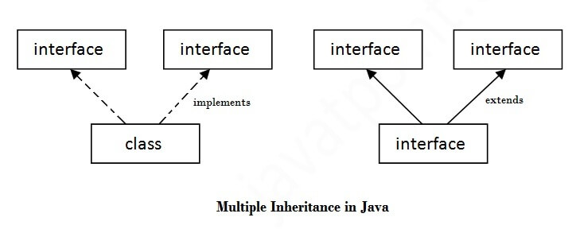
a class extends another class, an interface extends another interface, but a class implements an interface.
Interface do not have constructor.
If a class implements an interface and does not provide method bodies for all functions specified in the interface, then the class must be declared abstract and method definitions may be provided in the subclass.
Any class can extend only 1 class but can implement infinite number of interface.

Slide 4
Abstract Class vs Interface
Abstract Class | Interface
It is a class that contains one or more abstract methods, which are to be defined by sub class | It contains only method declarations and no definitions
Abstract class definition begins with keyword “abstract” followed by class definition | Interface definition begins with keyword “interface” followed by interface definition
Abstract classes can have general methods defined along with some methods with only declarations | Interfaces have all methods with only declarations that are defined in subclasses i.e. classes that implements the interface
Variables in abstract classes need not be public, static and final | All Variables in an interface is by default public, static and final
Abstract classes doesn’t support multiple inheritance | Interfaces supports multiple inheritance
An abstract class can contain private and protected members | An interface can only have public members
Abstract classes are fast | Interfaces are slow as it requires extra indirection to find corresponding methods in the actual class

Slide 5

Interface Example
import java.util.*;
interface Base {
public void read(float x);
public void calculate();
public void display();
}
class Sphere implements Base {
protected float r,vol;
public void read(float x)
{
r=x;
}
public void calculate()
{
vol=3.14f*r*r*r*4/3;
}
public void display()
{
System.out.println("Volume of Sphere = "+vol);
}}
class Hemisphere implements Base {
protected float r,vol;
public void read(float x)
{
r=x;
}
public void calculate()
{
vol=3.14f*r*r*r*2/3;
}
public void display()
{
System.out.println("Volume of Hemisphere = "+vol);
}}
class Main
{
public static void main(String args[])
{
float rad;
Scanner sc=new Scanner(System.in);
System.out.println("Enter Radius : ");
rad=sc.nextFloat();
Sphere s=new Sphere();
s.read(rad);
s.calculate();
s.display();
Hemisphere h=new Hemisphere();
h.read(rad);
h.calculate();
h.display();
}}

Slide 6
Packages
Package is a way to organize code i.e. similar function or related classes must be in a package.
Thus, one package will have all the classes of similar functionality while another package for another type of classes.
A java package is a group of similar types of classes, interfaces and sub-packages.
Package in java can be categorized in two form, built-in package and user-defined package.
There are many built-in packages such as java, lang, awt, javax, swing, net, io, util, sql etc.
Advantage of Java Package
Java package is used to categorize the classes and interfaces so that they can be easily maintained.
Java package provides access protection.
Java package removes naming collision.
Making searching/locating and usage of classes, interfaces, enumerations and annotations easier
All we need to do is put related classes into packages. After that, we can simply write an import class from existing packages and use it in our program.
We can reuse existing classes from the packages as many time as we need it in our program.

Slide 7
Creating a Package
Step-1 : To create a package we use the keyword “package” followed by the name of the package
Step-2 : Create a class and write members of the class
Step-3 : Store the program file in a folder with the same name as that of the package and store the file as the name of the class that has main() method. Eg : if the package name is “world”, then the folder in which the program is stored should also be “world”. If the name of the class having the main() method is “Hello”, then the program should be stored as “Hello.java”
Step-4 : Compile the program as usual using javac. This has to be done in the folder of the package. In case of above eg, in the folder ”world” we compile the file as javac Hello.java
Step-5 : Traverse out of the package folder and execute the program with syntax –
java package_name.class_name.
In the above eg, java world.Hello

Slide 8


Creating a Package
package pckg;
class Hello
{
public static void main(String args[])
{
System.out.println("Hello World !!!");
}
}

Slide 9
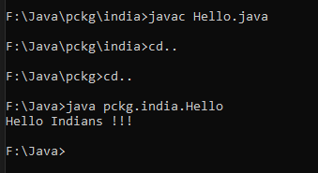
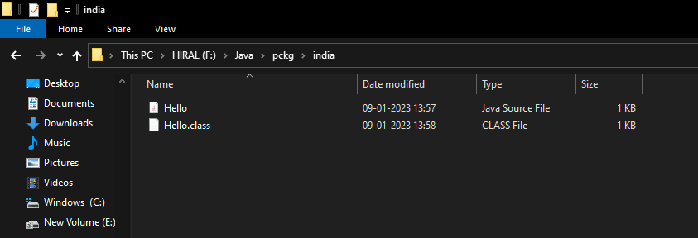
Creating a Sub-Package
To create a sub-package we use the same process that we used to create the package.
The folder of the sub package name has to be stored inside the folder with the package name.
package pckg.india;
class Hello
{
public static void main(String args[])
{
System.out.println("Hello Indians !!!");
}
}

Slide 10
Importing a Package
We have imported many built in packages like java.io, java.util,etc. as of now.
To import self made packages we follow the following steps –
Create the package as described in previous slides.
This package is to be imported by another program outside the folder with package name
That is we write two programs, one the package and another that imports the package. The package is to be stored in the folder with same name.

Slide 11
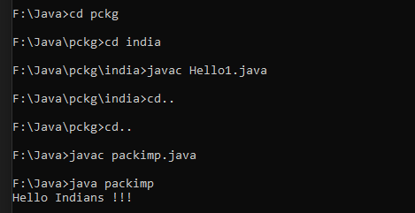
Importing a Package
The Package (Hello1.java)
package pckg.india;
public class Hello1
{
public void display()
{
System.out.println("Hello Indians !!!");
}
}
Importing Package (packimp.java)
import pckg.india.*;
class packimp
{
public static void main(String args[])
{
Hello1 h=new Hello1();
h.display();
}
}

Slide 12
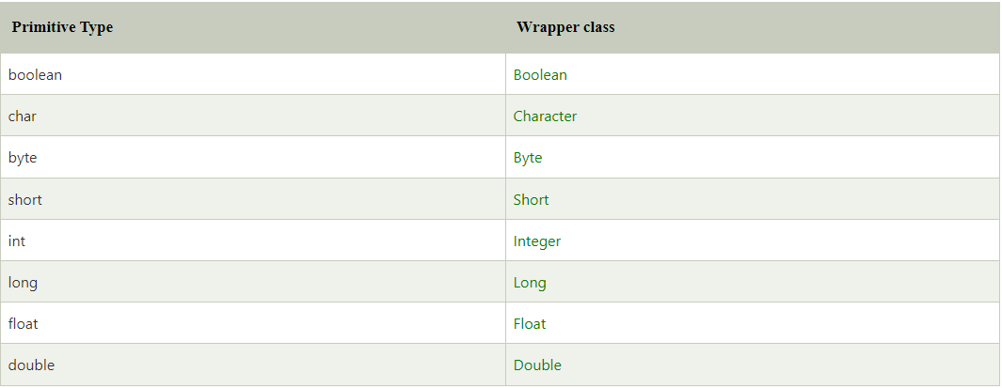
Exploring Important Java Packages
Java.lang
Java.io
Java.util
Wrapper Classes

Slide 13
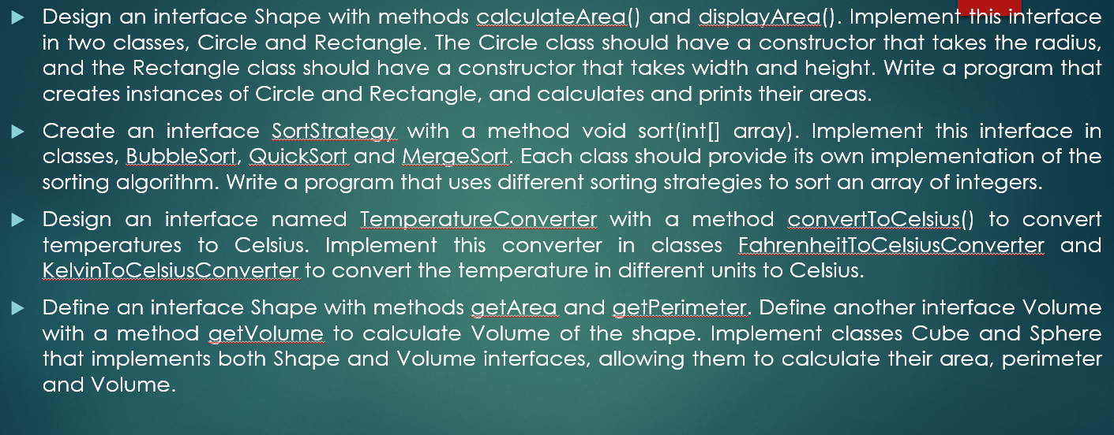
Programming Practice Questions

Slide 14
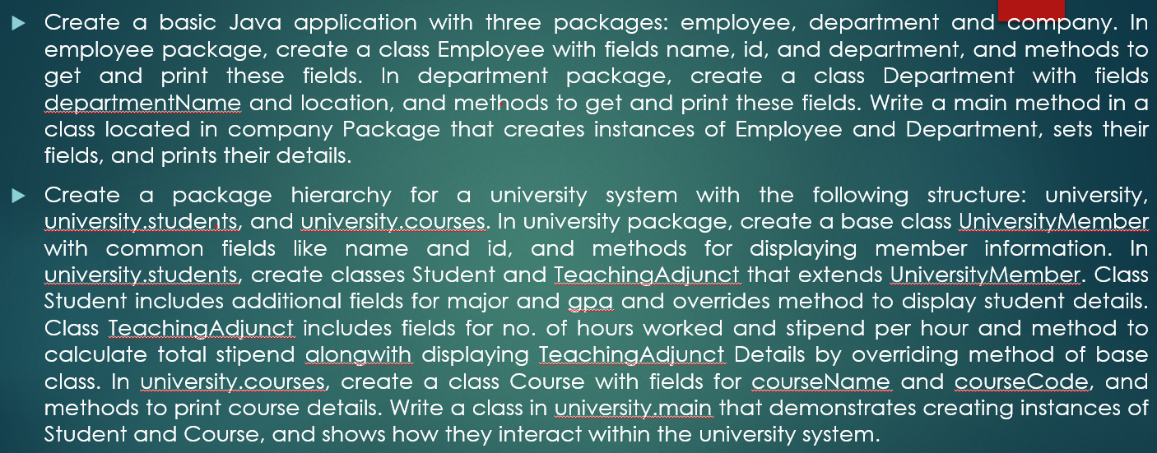
Programming Practice Questions

